Slide 1
InterAct Transnational Meeting 1 27.09. – 28.09.2021 Kiel, Germany

Slide 2
Structure
0. Introduction
1. Financial Aspects & Reporting
2. Monitoring
3. Dissemination
4. Next steps

Slide 3
0.
0
Introduction

Slide 4
Introduction
Erasmus+ Youth: 2020-3-DE04-KA205-02035
InterAct – Intercultural Action Competence Tool
The Project runs from 01.02.2021 - 31.07.2023
Coordinator: KulturLife gGmbH, Kiel, Germany

Slide 5
Introduction
Project partners:
Education for an Interdependent World (EDIW), Belgium
RIJKSUNIVERSITEIT GRONINGEN, Netherlands
MOBILIZING EXPERTISE AB, Sweden
DUN LAOGHAIRE INSTITUTE OF ART, DESIGN & TECHNOLOGY (IADT), Ireland
Stichting yEUth, Netherlands
ENTERPRENEURSHIP & SOCIAL ECONOMY GROUP, Greece
Please double check contact details on our partner list

Slide 6
Introduction
to promote and validate the development of Intercultural Action Competences (IAC) for participants in international youth projects
to transform the concept of IAC from theory to practice
web-based app that offers an approach to IAC
Manual for youth workers
Policy paper

Slide 7
1.
1
Financial Aspects

Slide 8
Budget
The maximum amount of the grant is 298.274,00 €

Slide 9
Project Management Fee
Contribution to the activities of the coordinating organisation:
500 EUR
per month
Contribution to the activities of the other participating organisations:
250 EUR
per participating organisation per month

Slide 10
Transnational Meetings
For travel distances between 100 and 1999KM:
575 EUR
per participant per meeting
For travel distances of 2000KM or more:
760 EUR
per participant per meeting

Slide 11
Reimbursement of Travel costs & documents I
travel documents
Reimbursement of 575/760 € after handing in the travel documents
Travel documents: Original Boarding Pass and/or other invoices
In case of travel from a place different than the one the sending organisation is located at and/or travel to a place different than the one the receiving organisation is located at leading to a change of distance band, the actual travel itinerary must be supported with travel tickets or other invoices specifying the place of departure and the place of arrival.

Slide 12
Reimbursement of Travel costs & documents II
Participants list
Certificates
Proof of attendance of the transnational project meeting in the form of a participants list signed by the participants and the receiving organisation specifying the name, date and place of the transnational project meeting, and for each participant: name and signature of the person, name and address of the sending organisation of the person;
Detailed agenda and any documents used or distributed at the transnational project meeting.
Certificates of attendance of the transnational project meeting

Slide 13
Reimbursement of Intellectual Output & documents
Time Sheets
Proof of the intellectual output produced, which will be uploaded in the Erasmus+ Project Results Platform and/or, depending on its nature, available for checks and audits at the premises of the beneficiaries;
Proof of the staff time invested in the production of the intellectual output in the form of a time sheet per person involved.
Participating organisations are supposed to fill in a time sheet once a month and send it to the coordinating organisation.

Slide 14
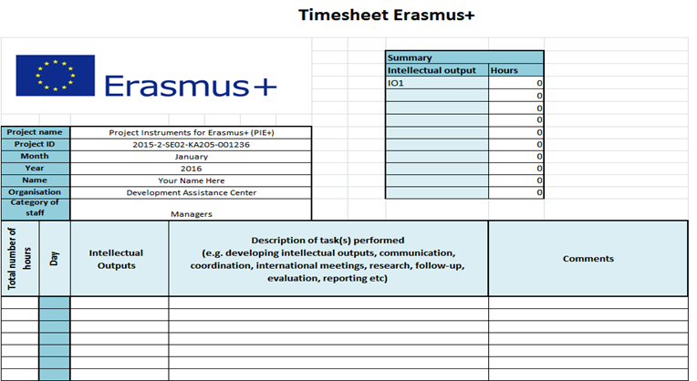
Example Time Sheet

Slide 15
Reimbursement of Intellectual Output & documents II
Declarations
Proof of the nature of the relationship between the person and the beneficiary concerned (such as type of employment contract, voluntary work, SME ownership, etc.), as registered in the official records of the beneficiary.
In all cases, the beneficiaries must be able to demonstrate the formal link with the person concerned, whether he/she is involved in the Project on a professional or voluntary basis. Persons working for a beneficiary on the basis of service contract (e.g. translators, web designer etc.) are not considered as staff of the organisation concerned.

Slide 16
Multiplier Events - Budget
Participants List
Documentary
100 EUR per local participant
(200 EUR per international participant)
Proof: participants list
Short documentary: description of the event, date, time, background of participants, pictures

Slide 17
2.
2
Monitoring

Slide 18
Time schedule
The timely achievement of all milestones is crucial to the overall success of the project.
Every TM coincides with a milestone, and every partner is committed to deliver his contributions in time.
The between-milestones call from the coordinating or quality partner is an early support and warning mechanism to become aware of any potential backlogs in time to work for alternative solutions.
The TMs will end with a to-do list for each partner to discuss and adopt a clear road-book for the interval until the next TM.
The TM will always start with a recapitulation of the prior to-do list and check the status of our work against the plan.

Slide 19
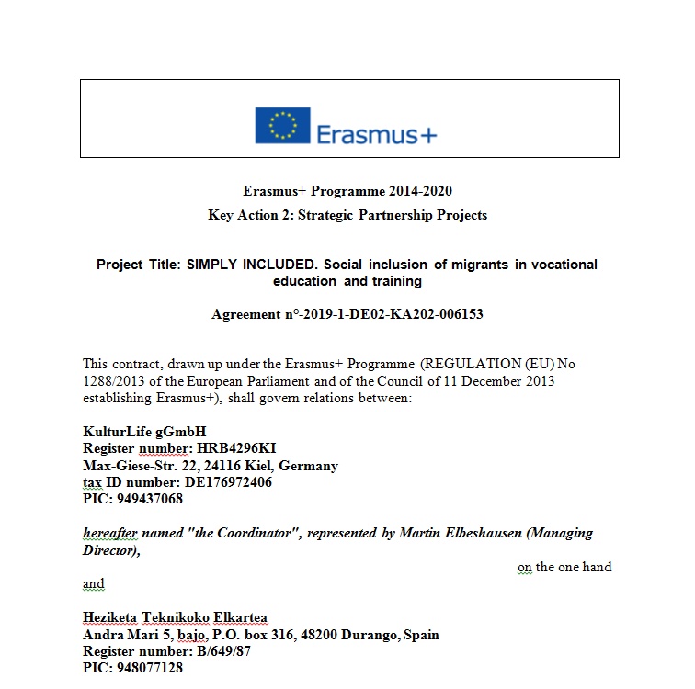
Partner Agreement

Slide 20
Communication I
Dropbox
KulturLife will set up a secure cloud space (Dropbox) for communication and sharing of documents (information, meeting minutes, work packages) within the partnership. This space will continue to be the basis also for dissemination of InterAct throughout the funding period. The results will be hosted free of charge by the KulturLife web presence and supported by its IT team.
Within the TM intervals, there will be several Zoom meetings, in which the partners can communicate in smaller groups to discuss relevant topics. Frequency: As often as needed, but at least once in between TMs.

Slide 21
Communication II
A Facebook group will bring all participants in close contact with each other. This tool will facilitate the informal networking, in particular amongst the young people.
All these media will be open to the participating youth workers and young migrants, and they will be opened to all youth organisations who are willing to apply and participate in the InterAct movement.

Slide 22
Budget Transfer without amendment
Without prejudice to Article II.13, the ceilings mentioned for each budget category in Annex IV and provided that the Project is implemented as described in Annex II, beneficiaries are allowed to adjust the estimated budget set out in Annex II by transfers between the different budget categories, without this adjustment being considered as an amendment of the Agreement within the meaning of Article II.13 provided that the following rules are respected:
(a) The beneficiaries are allowed to transfer up to 20% of the funds allocated for each of the following budget categories: Project management and implementation, Transnational Project Meetings, Intellectual Outputs, Multiplier Events, Learning/teaching/training activities and Exceptional costs to any other budget category with the exception of the budget categories Project management and implementation and Exceptional costs.
(b) Any budget transfer cannot result in an increase of more than 20% of the amount awarded to that budget category as specified in Annex II.

Slide 23
Budget Transfer without amendment II
(c) The beneficiaries are allowed to transfer funds allocated for any budget category to the budget category Special needs support, even if no funds are allocated for Special needs support as specified in Annex II. In such case the maximum increase of 20% of the budget category Special needs support does not apply.
(d) By derogation to point (a) of the present Article, the beneficiaries are allowed to transfer funds allocated for any budget category except Special needs support to the budget category Exceptional costs in order to contribute to the costs of a financial guarantee in so far as required by the NA in Article I.4.2 and even if no funds are allocated for Exceptional costs as specified in Annex II. In such case the maximum increase of 20% of the budget category Exceptional costs does not apply.

Slide 24
Budget control
Final report and request for payment of the balance
Within 60 days after the end date of the Project (31.07.2023), the coordinator must complete a final report on the implementation of the Project, and, when applicable, upload all project results in the Erasmus+ Project Results Platform as specified in article I.9.2. The report must contain the information needed to justify the contribution requested on the basis of unit contributions where the grant takes the form of the reimbursement of unit contribution or the eligible costs actually incurred in accordance with Annex III.
The final report is considered as the coordinator’s request for payment of the balance of the grant.

Slide 25
Risk management
Should there occur any problems or delays in completing a given task, the particpating organisation musst inform the coordinating organisation immediately in written form, in order to be able to find an appropriate solution.
The Risk Management Plan will be shared with all participating organisations and will be updated on a regular basis.
The use of SMART goals should serve as a powerful warning system regarding the intellectual outputs.

Slide 26
Use of IT tools
Mobility Tool+
The coordinator must make use of the web based Mobility Tool+ to record all information in relation to the activities undertaken under the Project and to complete and submit the Progress Report, Interim report (if available in Mobility Tool+ and for the cases specified in article I.4.3) and Final reports.
Erasmus+ Project Results Platform
The coordinator must input the deliverables of the Project in the Erasmus+ Project Results Platform (http://ec.europa.eu/programmes/erasmus-plus/projects/), in accordance with the instructions provided therein.
The approval of the final report will be subject to the upload of the Project deliverables in the Erasmus+ Project Results Platform by the time of its submission

Slide 27
3.
3
Dissemination

Slide 28
Choice of Logo – Option 1

Slide 29
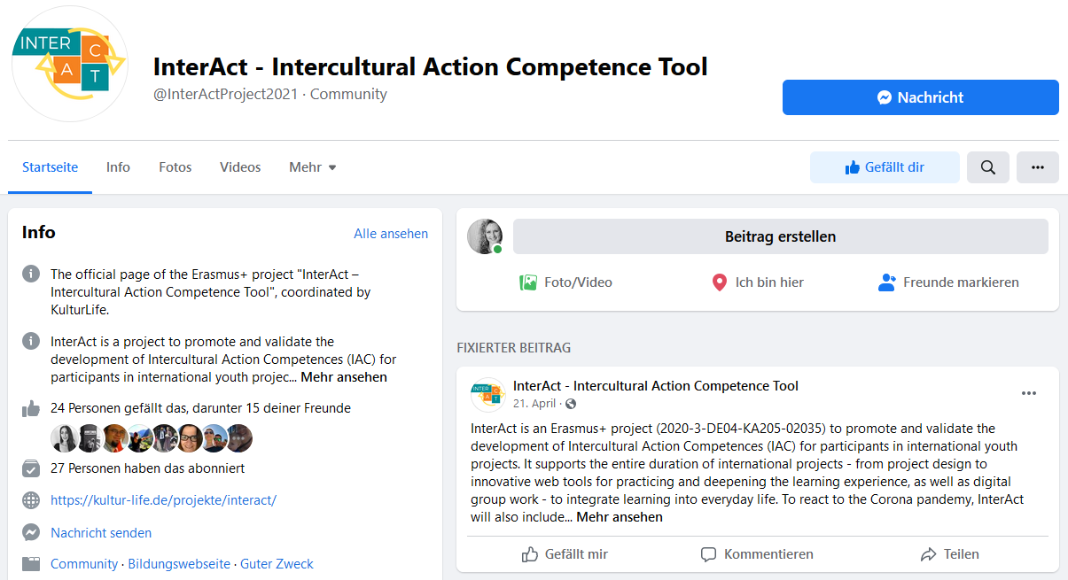
Facebook Page
https://www.facebook.com/InterActProject2021

Slide 30
Facebook Page
Dissemination Plan
Invite your network to join the Facebook group after TM1
Create Facebook articles according to the Dissemination Plan

Slide 31
Group Picture
Group Picture – Please smile ☺

Slide 32
4.
4
Next steps

Slide 33
Next steps
Info Travel Pack
Next TM2 will take place in Netherlands (hosted by RUG Groningen)in February 2022 – Date?
Approved budget for attendance:
KulturLife: 2 Persons
IADT: 2
EDIW: 1
EKO: 1
Mexpert: 2
RUG: 1
yEUth: 1

Slide 34
Next steps
What needs to be done before TM2?

Slide 35
End
Thank you for your attention!

