Slide 1
CROSS-BORDER CIRCULAR ECONOMY
CASE-STUDIES FROM GREECE

Slide 2
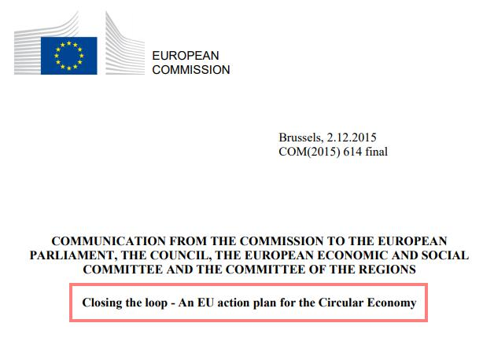
EC Action Plan for Circular Economy
Notes:
On December 2, 2015 the European Commission (EC) adopted an ambitious new Circular Economy Package to “stimulate Europe’s transition towards a Circular Economy, which will boost global competitiveness, foster economic growth and generate new jobs”.

Slide 3
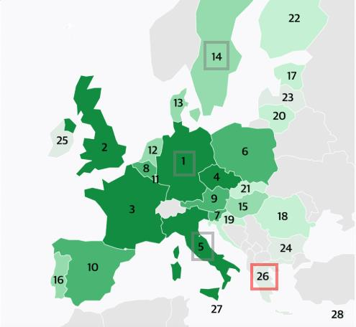
Circular Economy in Greece
Country (Rank) | Municipal waste (p.y p.p) | Food waste (p.y p.p) | Municipal recycling rate | Share of goods traded that are recycl. raw materials | Material reuse rate | Patents related to CE (since 2000) | Investment in CE sectors
Germany [1] | 627 kg | 149 kg | 66% | 0.25% | 11% | 1260 | €28.7M
Italy [5] | 497 kg | 179 kg | 45% | 0.19% | 19% | 294 | €17.8M
Sweden [14] | 443 kg | 212 kg | 49% | 0.19% | 7% | 49 | €4.1M
Greece [26] | 498 kg | 80 kg | 17% | 0.14% | 1% | 5 | €0.6M
Cyprus [28] | 640 kg | 327 kg | 17% | 0.13% | 3% | 4 | €0.1M
https://www.politico.eu/article/ranking-how-eu-countries-do-with-the-circular-economy/
Notes:
Source: https://www.politico.eu/article/ranking-how-eu-countries-do-with-the-circular-economy/
POLITICO's list ranking EU's economies according to circularity (POLITICO Europe is the European edition of the American news organization Politico reporting on the European Union. Its headquarters are located in Brussels with additional offices in London, Berlin, Warsaw, Paris, and Frankfurt)
The circular economy ranking varies significantly from the 2018 Environmental Performance Index, which is produced in part by the European Commission's Joint Research Centre and which ranks a broader range of environmental policies, from air pollution and emissions to agriculture and biodiversity.

Slide 4
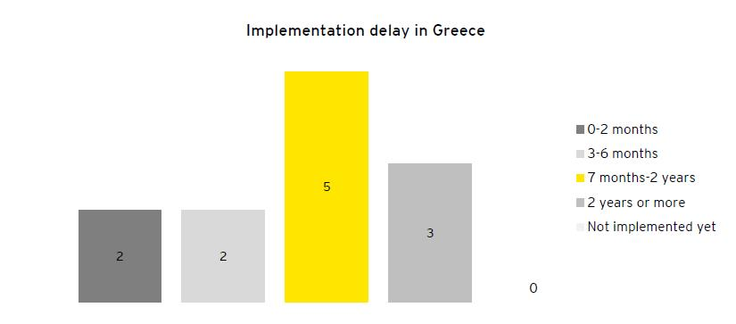
Key Reasons for Low Circularity
1) Delays/Failures in the implementation of the European legal framework on Circular Economy
Source: Study of SEV Business Council for Sustainable Development on Circular Economy in Greece (May 2016)
Notes:
Source: SEV Business Council for Sustainable Development (EY) founded by the Hellenic Federation of Enterprises (SEV) https://en.sev.org.gr/wp-content/uploads/2018/06/EY_Study_on_the_Circular_Economy_BRIEF-EDITION_0.pdf
Delays in implementation and failures in actual implementation of the European legal framework on the Circular Economy
existence of concurrent and contradictory legislations and regulations
non transparent and deficient licensing regimes for Circular Economy activities
lack of law enforcement
absence of sufficient audit mechanisms and subsequent delays in the imposition of administrative fines.
Graph 1> Delays in most cases seem to exceed the period of one or two years following the implementation deadline.
Graph 2 > An indicative example is found on implementation of Directive 94/62/EC on packaging and packaging waste, of 20 December 1994. Member States were required to comply with this Directive before the 30th of June 1996. In Greece, Law 2939/2001 implementing 94/62/EC Directive, was set into force on 6.8.2001, 5 years following the implementation deadline. As per art. 24 of said legislation, the National Organization for the Alternative Management of Packaging and Other Waste was established with the objective to draw the national strategy for alternative management of packaging. However the legislative act for the set-up and operation of this organization was issued only in 2008 (P.D. 170/2008). It is therefore evidenced that there was in fact a delay of 12 years for the actual implementation of this Directive.

Slide 5
Key Reasons for Low Circularity
2) Fragmented adoption of circular business models – mostly of one type of circular model, i.e. Resource Recovery
0 | 5 | 1 | 3 | 0
Source: Study of SEV Business Council for Sustainable Development on Circular Economy in Greece (May 2016)
Notes:
The study reveals that most of the sectors included under scope are in an early transitional phase towards the Circular Economy. This is true in terms of the adoption of mostly one type of circular model, which for most sectors was found to be ‘Resource Recovery’.
Circular Supplies: 0
Resource Recovery: Resource recovery model currently applied in Steel sector:
The Steel industry, uses exclusively scrap as its primary resource for the production of steel, thus reclaiming this valuable resource which would otherwise end up in landfills. All Greek steel makers apply the model of resource recovery, currently also widely applied by the steel makers in the EU.
Product life extension: currently applied in Construction sector:
Product life extension is currently a mainstream practice for the Construction sector. This is the case for maintenance and reparation of construction projects, as well as renovations in buildings. Extending the lifetime of a construction project is generally the preferred option against starting a new construction project from the beginning.
Sharing platforms: currently applied in the Electricity sector:
All electricity producers share a common transmission and distribution platform. The sharing platforms business model aims at increasing the utilization and value obtained from products and assets by promoting sharing among different users. Energy producers benefit from the use of the common networks avoiding unnecessary infrastructure development costs and at the same time the utilization of the existing transmission system and distribution network is maximized.
Calculation of the values??????

Slide 6
Key Reasons for Low Circularity
3) Energy is largely dependent on non-renewable sources and efficiency is relatively low
RES represented 16,5% in Greece compared to 23,5% at EU28 (2016)
Efficiency of electricity and heat production from conventional thermal plants in Greece was 37% compared to 48% for EU28 (2013)
4) Bio-waste and food waste recovery is limited, while Hazardous Waste management is still the area with the most deficiencies
Municipal waste is currently landfilled with only 19% getting recovered, compared to the EU target for 2030 (for Greece 2035) of 65%
The fines imposed on Greece on illegal landfills and treatment of hazardous waste are among the highest within the EU and
Source: Study of SEV Business Council for Sustainable Development on Circular Economy in Greece (May 2016)
Notes:
3) Non-renewable sources are the main source of energy for all sectors under scope (
1.Aluminium
2.Cement
3.Construction
4.Electricity
5.Food & Beverage
6.Information and Communications Technology (ICT)
7.Refining
8.Steel)
, a key characteristic of a linear economy. This is due to the fact that all of the sectors under the scope of the study use electricity from the national grid as their primary source of energy, which mainly originates from non-renewable sources.
4) Mixed waste in Greece is collected by local authorities in cooperation with the Hellenic Recovery Recycling Corporation. The collected waste is either landfilled or subject to treatment in ΜΒΤ plants. Household bio-waste in Greece is mostly food waste (resulting from the consumption phase) and according to the national waste management plan approximately 44% of municipal waste is bio-waste; the majority of which being food waste, and overall, municipal waste is currently landfilled with only 19% getting recovered. However, during the processing phase, resource recovery takes place and bio waste produced is used by the same and other industries as input resources. For example, bio waste is used for the production of animal food.

Slide 7
On the positive side…
Endorsement of a National Action Plan on Circular Economy in April 2018
Actors such as businesses, industry and the civil society are key drivers in the transition process towards a Circular Economy in Greece
Notes:
National Action Plan includes:
1. Regulatory and Legislative Reforms
2. Actions to improve financing
3. Know-how and Information Actions
4. Governance Actions
Υπουργείο Περιβάλλοντος & Ενέργειας: http://www.ypeka.gr/LinkClick.aspx?fileticket=pYSLQXgjjOU%3D&tabid=37&language=en-US

Slide 8
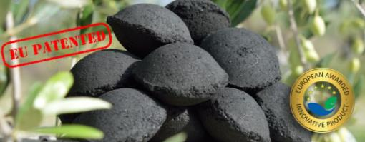
Good practices of Circular Economy #1
The Practice | Greek olive pits → heating fuel for the production of lime pulp (for use in building construction) & lime powder (for use in agriculture) Incomplete combustion of Greek olive pits → Black powder → Barbeque Briquettes → 30% less CO than wood charcoal
The Results | Efficient use of natural resources without interfering with the life-cycle of olive trees. Upcycling of combustion products. Barbecue briquettes which emit 30% less carbon monoxide than wood charcoal.
Circular Model | Recovering remaining value from products that have reached their end-of-life or from by-products
Notes:
https://klimiscoal.gr/en/
Description:
Since its establishment in 1968, KLIMIS has been using the woody part of Greek olive pits as heating fuel for its kiln in order to bake lime stones, and produce lime pulp (putty lime) for use in building construction and lime powder (quick lime) for use in agriculture.
The woody part of olive pits (a by-product from pomace factories) is a solid and sustainable biomass fuel, and therefore a renewable energy source derived from the process of collecting olive oil. KLIMIS compresses olive pits either in an oval shape to create briquettes or in a polygonal shape to create logs (with a hole along their axes) suitable for stoves, wood boilers, pyrolisis boilers and fireplaces. They are 100% natural products, free from chemicals and have a high heating power of 5153kcal/kg.
Since 1992, after lengthy experiments, KLIMIS has also been collecting the black powder produced by the incomplete combustion of the woody part of olive pits in the kiln to create (EU-patented) barbecue briquettes which do not emit odours, or produce smoke or sparkles. They are easy to light up, free from chemicals, have a high heating power of 6366 kcal/kg, and emit 30% less carbon monoxide than wood charcoal.

Slide 9
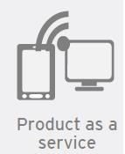
Good practices of Circular Economy #2
The Practice | CSR developing energy- and resource-saving solutions & circular economy models for environmental infrastructure installations and operations
The Results | Solid Waste: Creation of 20 sanitary landfills, construction of 2 MBT factories Water Cycle: Upgrade of 28 WWTPs, 7 de-salination Units Land Reclamation: restoration of 112 illegal landfills Energy: Services for the collection and exploitation of biogas in 5 landfills, Energy Efficiency Upgrades in two Greek Municipalities Other services: Organic waste collection and transportation services (e.g. LIFE-F4F project)
Circular Model
Notes:
https://www.thalis-es.gr/index.php/en/
CSR developing energy- and resource-saving solutions & circular economy models for environmental infrastructure installations and operations
Prefabricated systems for water and wastewater treatment
Provides Services, develops tools and undertakes projects for helping clients improve environmental infrastucture facilities (solid waste management, energy footprint optimization & land reclamation)
Operates mainly in Greece, but is also starts to expand in MENA and African countries (e.g. wastewater system installations in 7 settlements in Ethiopia, serving in total 100.000 people
Mechanical biological treatment (MBT) system is a waste processing facility that combines a waste sorting facility with biological treatment methods e.g. anaerobic digestion and/or composting. MBT plants are designed to process mixed household waste as well as commercial and industrial waste
The products of the Mechanical Biological Treatment technology are:
Recyclable materials such as metals, paper, plastics, glass etc.
Unusable materials (inert materials) safely disposed to sanitary landfill
Biogas (anaerobic digestion)
Organic stabilized end product
Refuse derived fuel - RDF (High calorific fraction).
A key advantage of MBT is that it can be configured to achieve several different aims. Some typical aims of MBT plants include the: Pre-treatment of waste going to landfill; Diversion of non-biodegradable and biodegradable MSW going to landfill through the mechanical sorting of MSW into materials for recycling and/or energy recovery as refuse derived fuel (RDF); Diversion of biodegradable MSW going to landfill by: o Reducing the dry mass of organic waste prior to landfill; o Reducing the biodegradability of organic waste prior to landfill; Stabilisation into a compost-like output for use on land; Conversion into a combustible biogas for energy recovery; and/or Drying materials to produce a high calorific organic rich fraction for use as RDF
WWTPs = Waste Water Treatment Plants

Slide 10
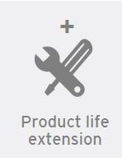
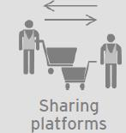
Good practices of Circular Economy #3
The Practice | Waste Electrical & Electronic Equipment (WEEE) sorting centers → Attica & Central Macedonia → collection sorting & preparation for reuse or treatment of WEEE Development of a web platform for households, companies & public services → donation and exchange of EEE Repair cafés → give the public the chance to repair their appliances with the help of technicians
The Results | Maintaining WEEE in a working condition for a longer period of time Spreading awareness and creating a culture of prevention and reuse in Greece Developing a suitable institutional framework governing all aspects of WEEE preparation for reuse
Circular Model
Cross - Border
Notes:
https://www.reweee.gr/en
Among the project partners are RReuse, the Hellenic Recycling Agency, the Ecological Recycling Society, the Green Fund and the Harokopio University of Athens.
RREUSE is a European organization which represents national and regional networks of social enterprises in the EU which engage in reuse, repair and recycling activities. Currently, RREUSE represents some 77 000 employees and over 60 000 persons who are reintegrated in the labor market from 30 member organizations active in 16 EU Member States.
Ecological Recycling Society → runs the “Observatory of Circular Economy”

Slide 11
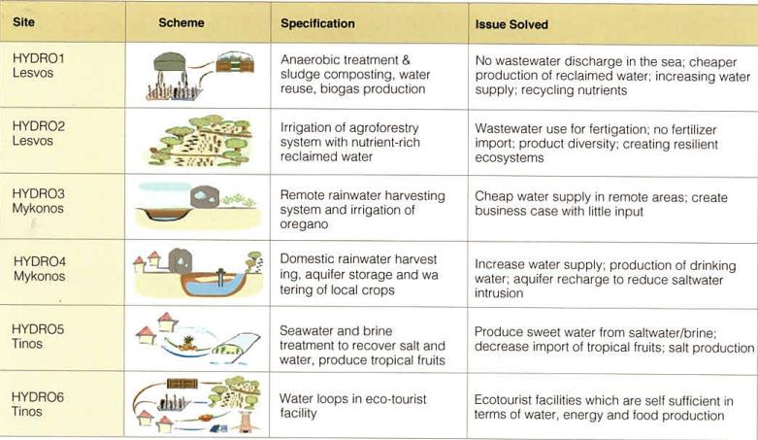
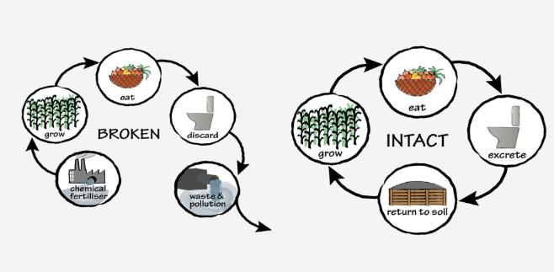
Good practices of Circular Economy #4
The Practice | HORIZON 2020 project (Start date: 01/07/2018, 27 partners from GR, IT, DE, UK, ESP, FR, AT, EG, BE) Main aim: Promote innovative water and waste-water management approaches to close Water Loops in water-scarce regions taking advantage of local resources
Notes:
https://www.hydrousa.org/
Leader: National Technical University of Athens
Aim: Innovative water and waste-water management through the production of water for irrigation and human consumption
Innovative, regenerative and circular solutions for:
nature-based water management of Mediterranean coastal areas, closing water loops
(such as domestic rainwater harvest or seawater and brine treatment to produce drinking water / sweet water for irrigation & salt respectively)
2) nutrient management, boosting the agricultural and energy profile
Anaerobic treatment & sludge composting for nutrients recycling
3) local economies, based on circular value chains
Water loops in eco-tourist facility → Ecotourist facilities that are self-sufficient in terms of water, energy and food

Slide 12
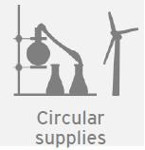
Good practices of Circular Economy #4
Expected Results | Non-conventional water sources & smart water services to close the cycles of materials, water & energy at regional scale Enhancing interconnectivity between the water system and other economic and social sectors. Providing evidence-based knowledge to facilitate a broader transition to a circular economy in the EU and beyond
Circular Model
Cross - Border
Notes:
Circular supplies: companies swift from finite, non-renewable input resources to ones that are renewable, bio-based and biodegradable. This way companies can stop putting pressure on finite and in many times scarce stocks all the while safeguard themselves from resource availability and price volatility issues.
Resource Recovery: The resource recovery business model builds upon existing recycling and reverse logistics structures and through innovative initiatives aims to minimize waste by recovering every possible remaining value from products that have reached their end-of-life or from by-products. For example, energy could be recovered from organic by-products or waste and products that have been designed with eco-design principles could be used in the manufacturing of new and different products.

Slide 13
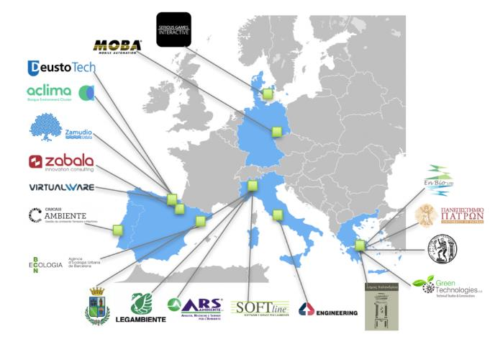
Good practices of Circular Economy #5
Horizon 2020: improvement of all
waste management stages, focusing on citizen participation
Notes:
https://waste4think.eu/halandri
The European WASTE4Think project, led by the DeustoTech institute of technology at the University of Deusto, seeks to design solutions based on the use of information and communication technologies that would enable the improvement of all waste management stages, adopting a global approach and particularly focusing on citizen participation in order to build more sustainable, eco-friendly cities.
Objectives
The main objective of Waste4Think is to move forward the current waste management practices into a circular economy motto demonstrating the value of integrating and validating 20 eco-innovative solutions that cover all the waste value chain.
Attached to this main objective a set of specific ones have been defined to indicate what the project will be focused into:
To reduce generation of waste thanks to prevention campaigns and cooperative activities to promote reuse and eco-design solutions.
To promote behavioural changes in the waste generators by awareness campaigns and new educational tools in order to foster more sustainable consumption and production habits and to increase the rate of waste sorting.
To improve the integral waste management services reducing their management costs and the GHG (greenhouse gas) emissions.
To reduce the amount of primary waste deposited in landfill to zero and to the maximum in case of secondary waste.
To identify the waste products with a low potential for recycling and to propose eco-innovative valorisation and production solutions.
To assess the transferability to the market of the new proposed eco-innovative solutions.
The solutions include technological and non-technological approaches. The benefits of these solutions will be enhanced by a holistic waste data management methodology, and will be demonstrated in 4 complementary urban areas in Europe:
1) Zamudio (Spain) 2) Halandri > PILOT COORDINATOR NTUA Contact: Gerasimos Lyberatos
3) Seveso (IT) 4) Cascais (Portugal)

Slide 14
Thank you
for your
attention!

