Slide 1
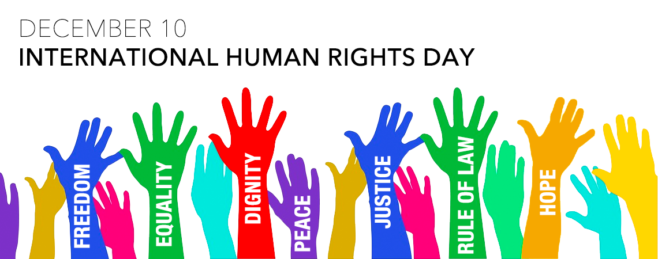

Slide 2
Human Rights
Human Rights are the rights people are entitled to simply because the are human beings.
They are
Universal: belong to all people
Inalienable: cannot be taken away
Indivisible: cannot be treated in isolation
Interconnected: are dependent on one an other
Non-discriminatory: should be respected without prejudice
The modern affirmation of Human Rights came after the 2WW, with the creation of the United Nations
  → an intergovernmental organization responsible for maintaining international peace and security, developing friendly relations among nations, achieving international cooperation, and being a center for harmonizing the actions of nations.

Slide 3
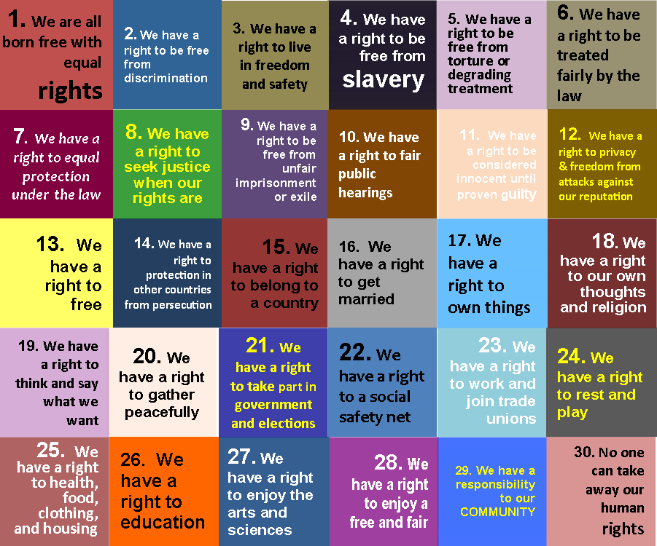
The 30 Human Rights

Slide 4
The Universal Declaration of Human Rights
On 10 December 1948 the United Nations General Assembly adopted the Universal Declaration of Human Rights (UDHR): a milestone document in the history of human rights.
Motivated by the experiences of the preceding world wars, the international community thought it was important to emphasize the concept of human dignity and the Universal Declaration was drafted by representatives with different legal and cultural backgrounds from all regions of the world.
For the first time, it set out fundamental human rights to be universally protected, proclaiming the inalienable rights which everyone is inherently entitled to as a human being regardless of race, colour, religion, sex, language, political or other opinion, national or social origin, property, birth or other status.
The Universal Declaration includes civil and political rights, like the right to life, liberty, free speech and privacy. It also includes economic, social and cultural rights, like the right to social security, health and education.
Available in more than 500 hundred languages, it is the most translated document in the world.

Slide 5
